Slide 1

Digital Electronic Systems
IY426
Combinational Basics: Exercises
Monday 24-Jan-2022

Slide 2
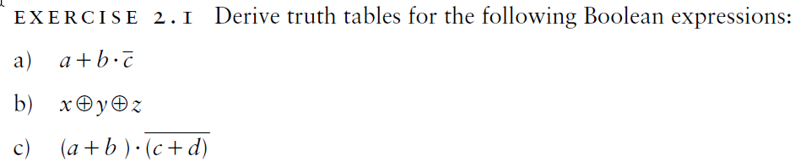
Exercises

Slide 3
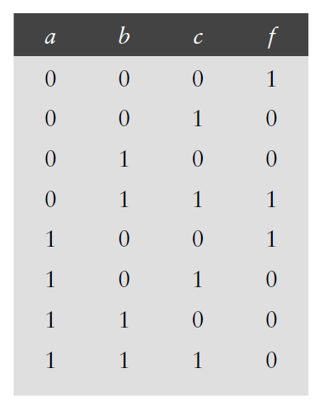
Exercises
Given this truth table, write a Boolean expression
for the function f, expressed as a sum of minterms.

Slide 4
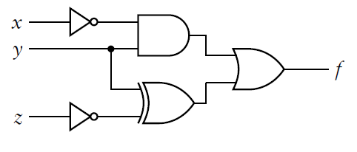




Exercises
Determine the output waveform for this logic circuit.
$$x$$
$$y$$
$$z$$
$$f$$

Slide 5
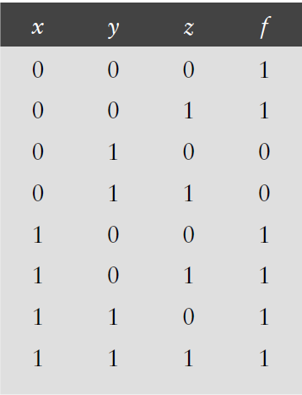
Exercises
Reduce the size of this truth table by using the don’t care notation for inputs.

Slide 6
Exercises
Use the laws of Boolean algebra to prove that these Boolean
Expressions are equivalent.

Slide 7
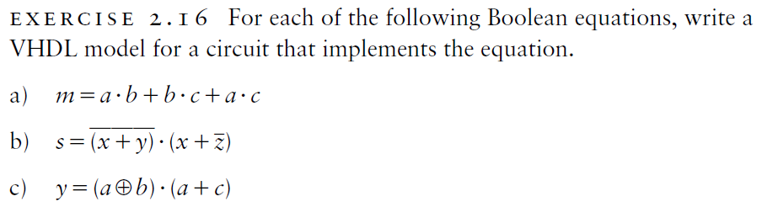
Exercises

